Slide 1
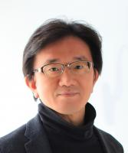
COOL
Lecture
2023
Communicating with Outstanding Science Leaders
30th, Nov | Cardiovascular and Metabolic Disease Center
College of Medicine, Inje University |
Motohiro Nishida
Professor, Graduate School of Pharmaceutical Sciences Kyushu University/
FEATURING:
Sulfide metabolism in
cardiac stress resistance
Cardiovascular Metabolic
Disease Center
National Research Laboratory for
MITOCHONDRIAL SIGNALING

